Slide 1
Machine Intelligence with Deep Learning Importance batching for improved training of neural networks
Samik Real, Jonathan Gadea Harder, Johannes Hötter
02.12.2019

Slide 2
Agenda
Introduction to the problem
Our current results
Fashion-MNIST
CIFAR-10
CIFAR-100
Next steps

Slide 3
Introduction to the problem
Stochastic learning splits data into multiple batches of a maximum size k
For instance: 11 images split into 4 batches with at most 3 samples each
k = 3
Necessary if dataset is too large for RAM
Speeds up training and helps model to converge due to added noise
Usually batches are created randomly
Is there a better approach ?!

Slide 4
Introduction to the problem
How we created batches so far:
Freezing the data
Shuffling the data

Slide 5
Introduction to the problem
How we created batches so far:
Sorting the data homogeneously
Sorting the data heterogeneously

Slide 6
Our current results
1st experiment: Fashion-MNIST
70,000 gray-scale 28x28 images (6:1 train/test split) with 10 classes
Model used: Custom convolutional neural network
4 layers: 3 conv layers + 1 FC layer
Conv layers: 64, 128, 64
filter sizes: 2x2
activation: PReLU
Max Pooling (2x2) after every conv layer
Dropout (0.5) used on FC layer

Slide 7
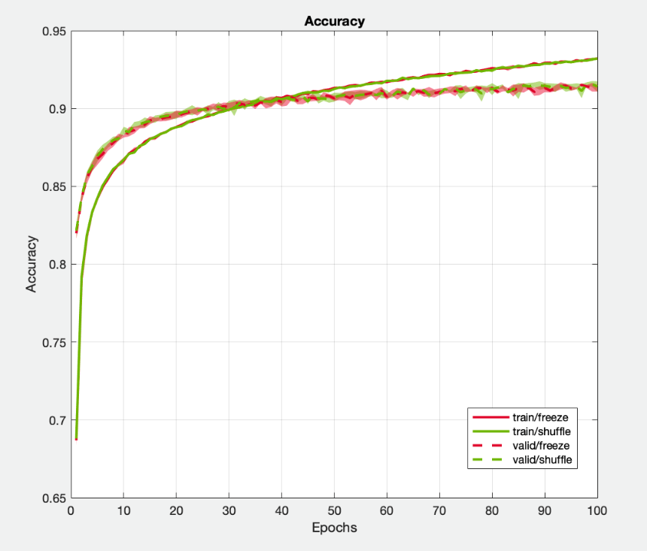
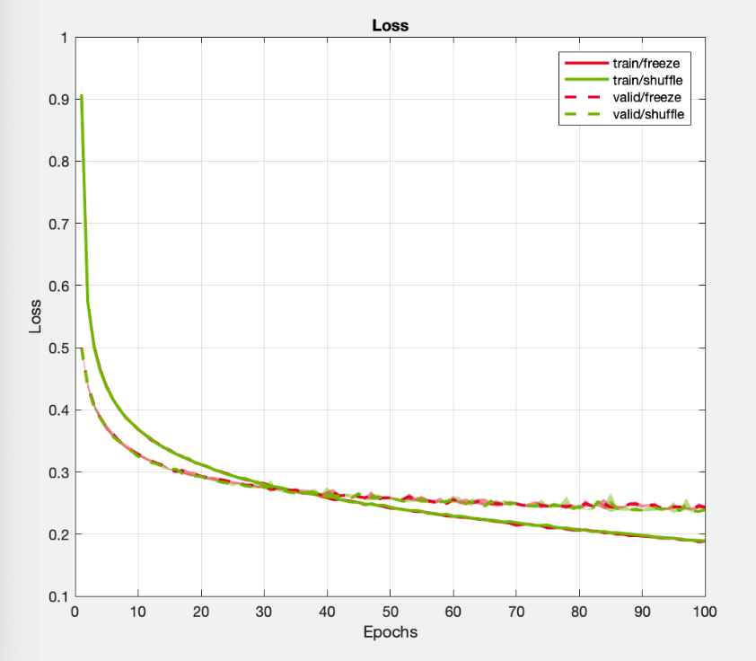
Our current results

Slide 8
Our current results
2nd experiment: CIFAR-10
60,000 32x32 rgb images (i.e. 3x32x32 tensors) with 10 classes, uniformly distributed along all images
Model used for classification: ResNet with 18 layers

Slide 9
Our current results
Change of accuracy over epochs
Change of loss over epochs
accuracy in %
cross entropy loss
epochs
epochs

Slide 10
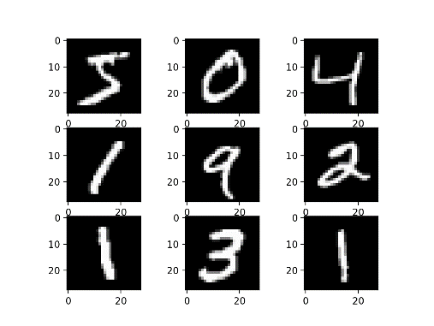
Our current results
3rd experiment: MNIST
70,000 gray-scale 28x28 images (6:1 train/test split) with 10 classes
Model used: Custom convolutional neural network
3 layers: 2 conv layers + 1 FC layer
Conv layers: 64, 32
filter sizes: 2x2
activation: ReLU in conv layers+ softmax in FC layer
Max Pooling (2x2) after every conv layer
Dropout (0.3) used on conv layer, Dropout (0.5) used on FC layer

Slide 11
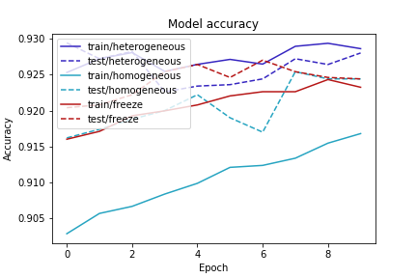
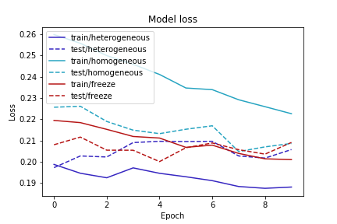
Our current results

Slide 12
Next steps
Implementing the weighted random sampling method
Experimenting with different ideas to sort the data for training
Sorting the data by the computed loss of each input globally
Sorting the data by the computed loss of each input per class
Creating batches of dynamic sizes (i.e. increasing/decreasing k)

Slide 13

Thank you for your attention!
Samik Real, Jonathan Gadea Harder, Johannes Hötter
02.12.2019

